Slide 1

September 2022
Stata workshop
Statistical Software in Public Policy Workshop Series
Alfonso Rojas-Álvarez, Ph.D.
LBJ School of Public Affairs, The University of Texas at Austin

Slide 2
Welcome!
First of six statistical software workshops in the Fall:
September 9: Introduction to Stata in public policy
September 16: Stata lab
September 23: Introduction to Excel in public policy
September 30: Excel lab
October 14: Introduction to R in public policy
October 21: R lab
Fridays, from 12:15 to 1:45pm, in SRH 3.312/3.360

Slide 3
About these workshops
Workshops are à la carte; come to any you choose based on your needs.
There is no evaluation, evaluation or required participation.
The labs will usually build upon the content of the intro session.
We assume no previous exposure to the software.
We won’t be going over installation of the software.
1 hour of lecture and 10-15 minutes of Q&A and troubleshooting
Feel free to ask questions whenever!
Office Hours for technical, software or installation assistance (or anything else):
Monday 10-11:30am; Thursday 2-3:30pm, in SRH 3.264.

Slide 4
Introduction to Stata in Public Policy
Contents for today’s workshop:
What is Stata
First steps on using Stata – sample data set
Basic exploratory and cleaning commands
EDA and combining
Scripting (do-files)
Advanced applications (regression, panel data)

Slide 5
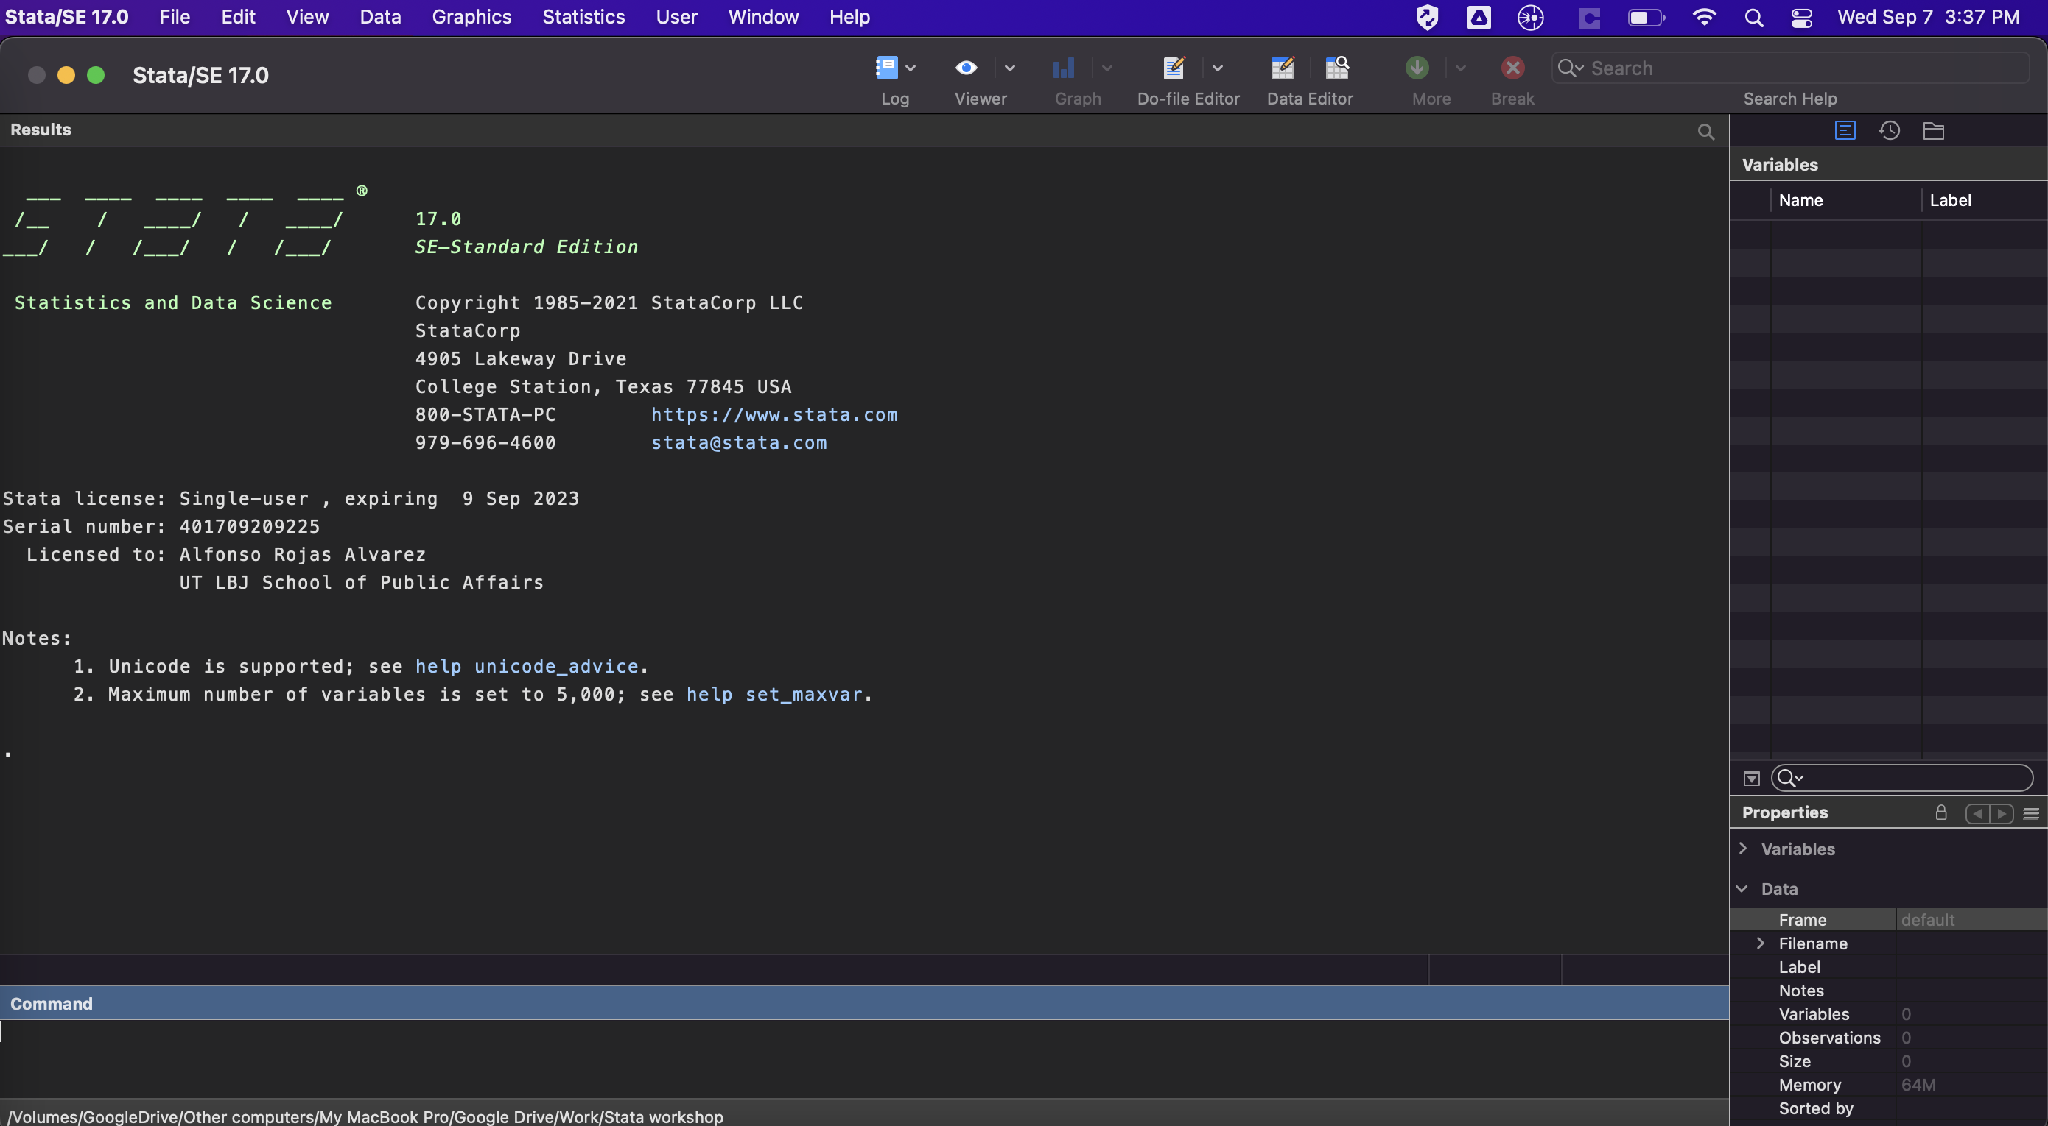
What is Stata?
Statistical software package for datasets:
Explore,
Summarize
Analyze
Predominant:
Social sciences
Economics
Public policy
Available:
LBJ School labs
CNS Stats Server

Slide 6
Initial setup
Set your working directory
Create a do-file
“Code or no-code” --> choose your own adventure
Open a dataset (.dta or import excel, csv and others)
Sample dataset for today: sysuse census.dta
Edit data (careful!)
Color coding and variable types
Save your data
More advanced tasks:
Create a log
Memory allocation

Slide 7
Basic exploratory and cleaning commands
Exploring:
describe, summarize, tab, table, crosstabs, tabstats
“if” commands
Cleaning:
rename, label, gen
egen, create id’s, sort
drop, keep
Options for each command:
Use help!
Use Stackoverflow!

Slide 8
Exploratory Data Analysis and Combining
Plots
Scatterplots
Histograms
Boxplots
Density plots
Titles, legends, axis, and others.
Combining datasets
Why do we want to combine?
Append or merge?
Link variable for merging
Common frames for appending
One to one, many to one, many to many

Slide 9
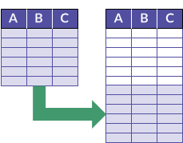
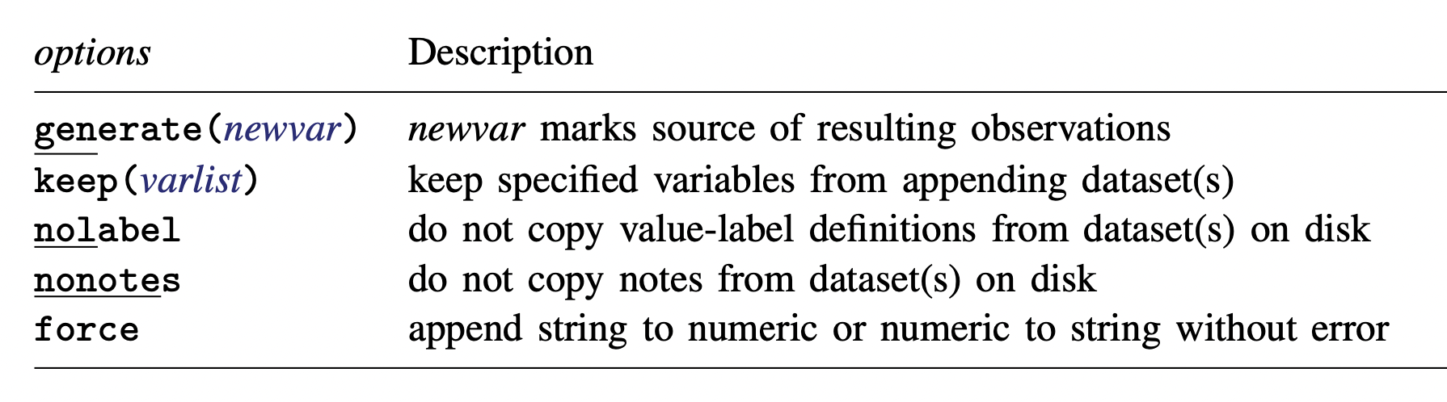
Append
You’re adding rows to an existing frame
Open dataset X, have Y in same directory
You need the variables to match
append using y
Y
X
Image Credit: HighBond

Slide 10
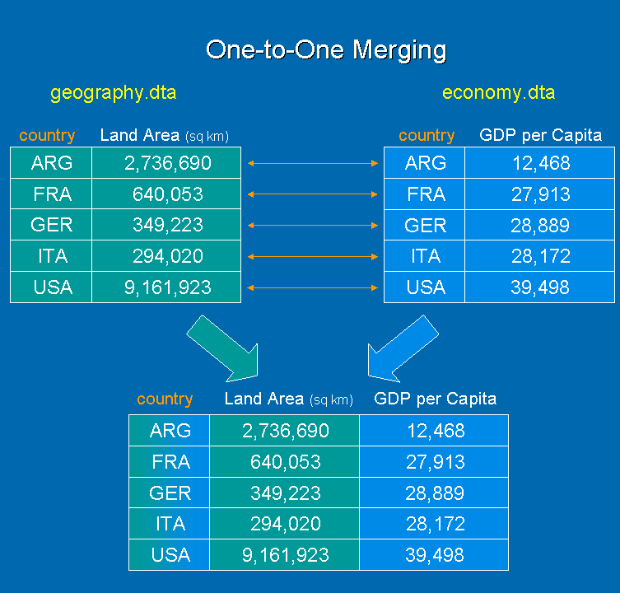
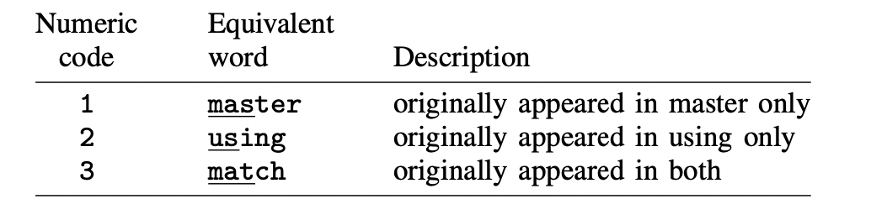
Merge
You’re adding columns using a link variable
Open dataset X, have Y in same directory, sort
Variables don’t have to match
Rows can (and should) match but don’t have to
_merge variable provides key information:
merge country using geography.dta
Y
X
Image Credit: StataProject Blog

Slide 11
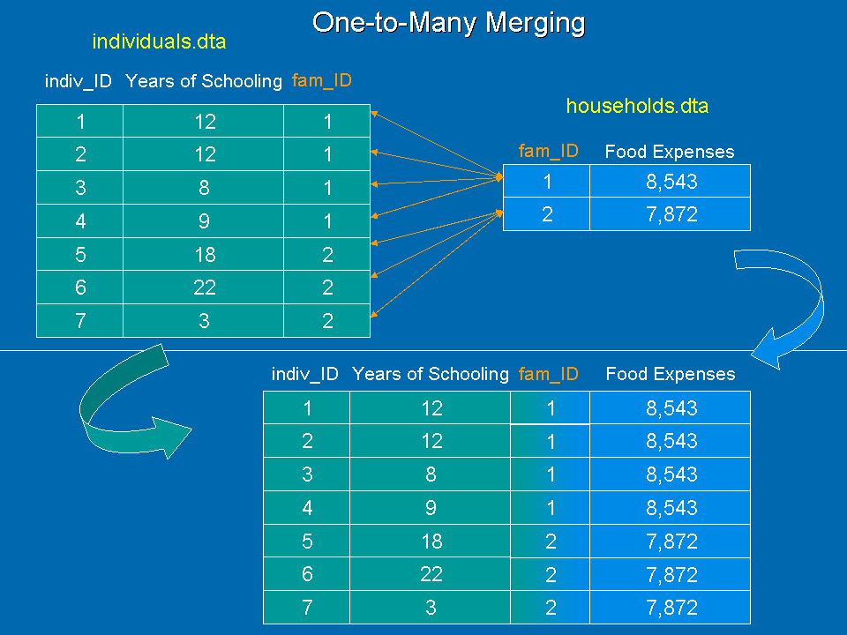
One-to-Many Merge
Several observations per identifier
Open dataset X, have Y in same directory, sort
Variables don’t have to match
Be very careful! Validate before saving
Many-to-one also works!
Avoid many-to-many if possible
merge 1:m fam_id using individuals.dta
Y
X
Image Credit: StataProject Blog

Slide 12
Scripting in Stata
The power of do-files
Replicability and version control
Sharing and exchanging scripts (code)
Time saving

Slide 13
Advanced applications
Regression
Panel data (fe and re)
Classification (logistic and glm)
Estimation (error estimation and others)

Slide 14
Stata Lab
We will use a CPS data set to study gender pay gaps.
https://github.com/LBJ-SoftwareWorkshops
Data set is from Kaggle, great resource for data.
You can explore the data set however you want, and run a few regressions!
Let’s discuss how to go about it.
Share with us your results.
I can help you build your ideas.

Slide 15
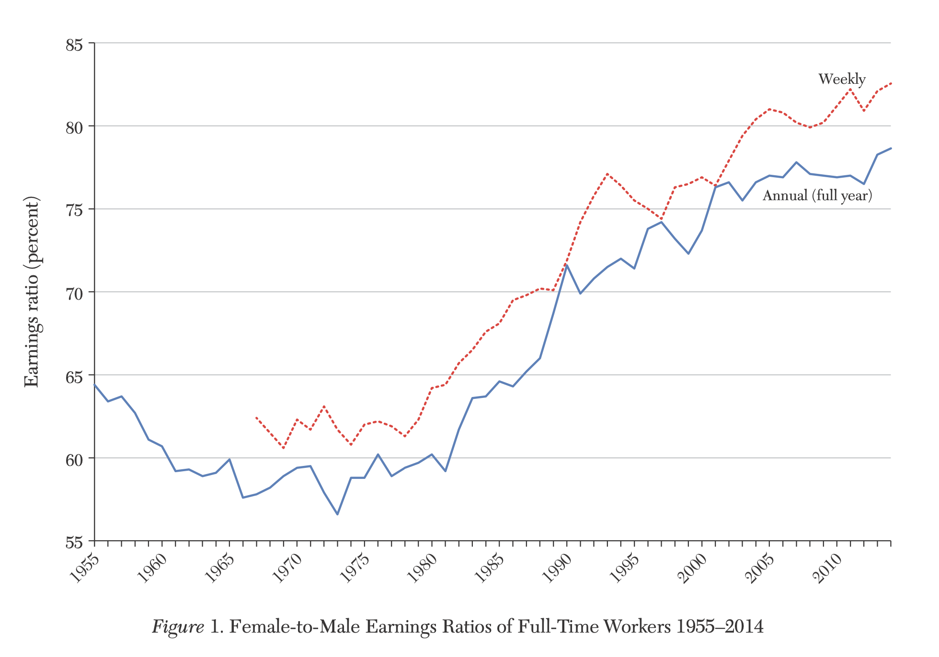
Emulate Figure 1

Slide 16
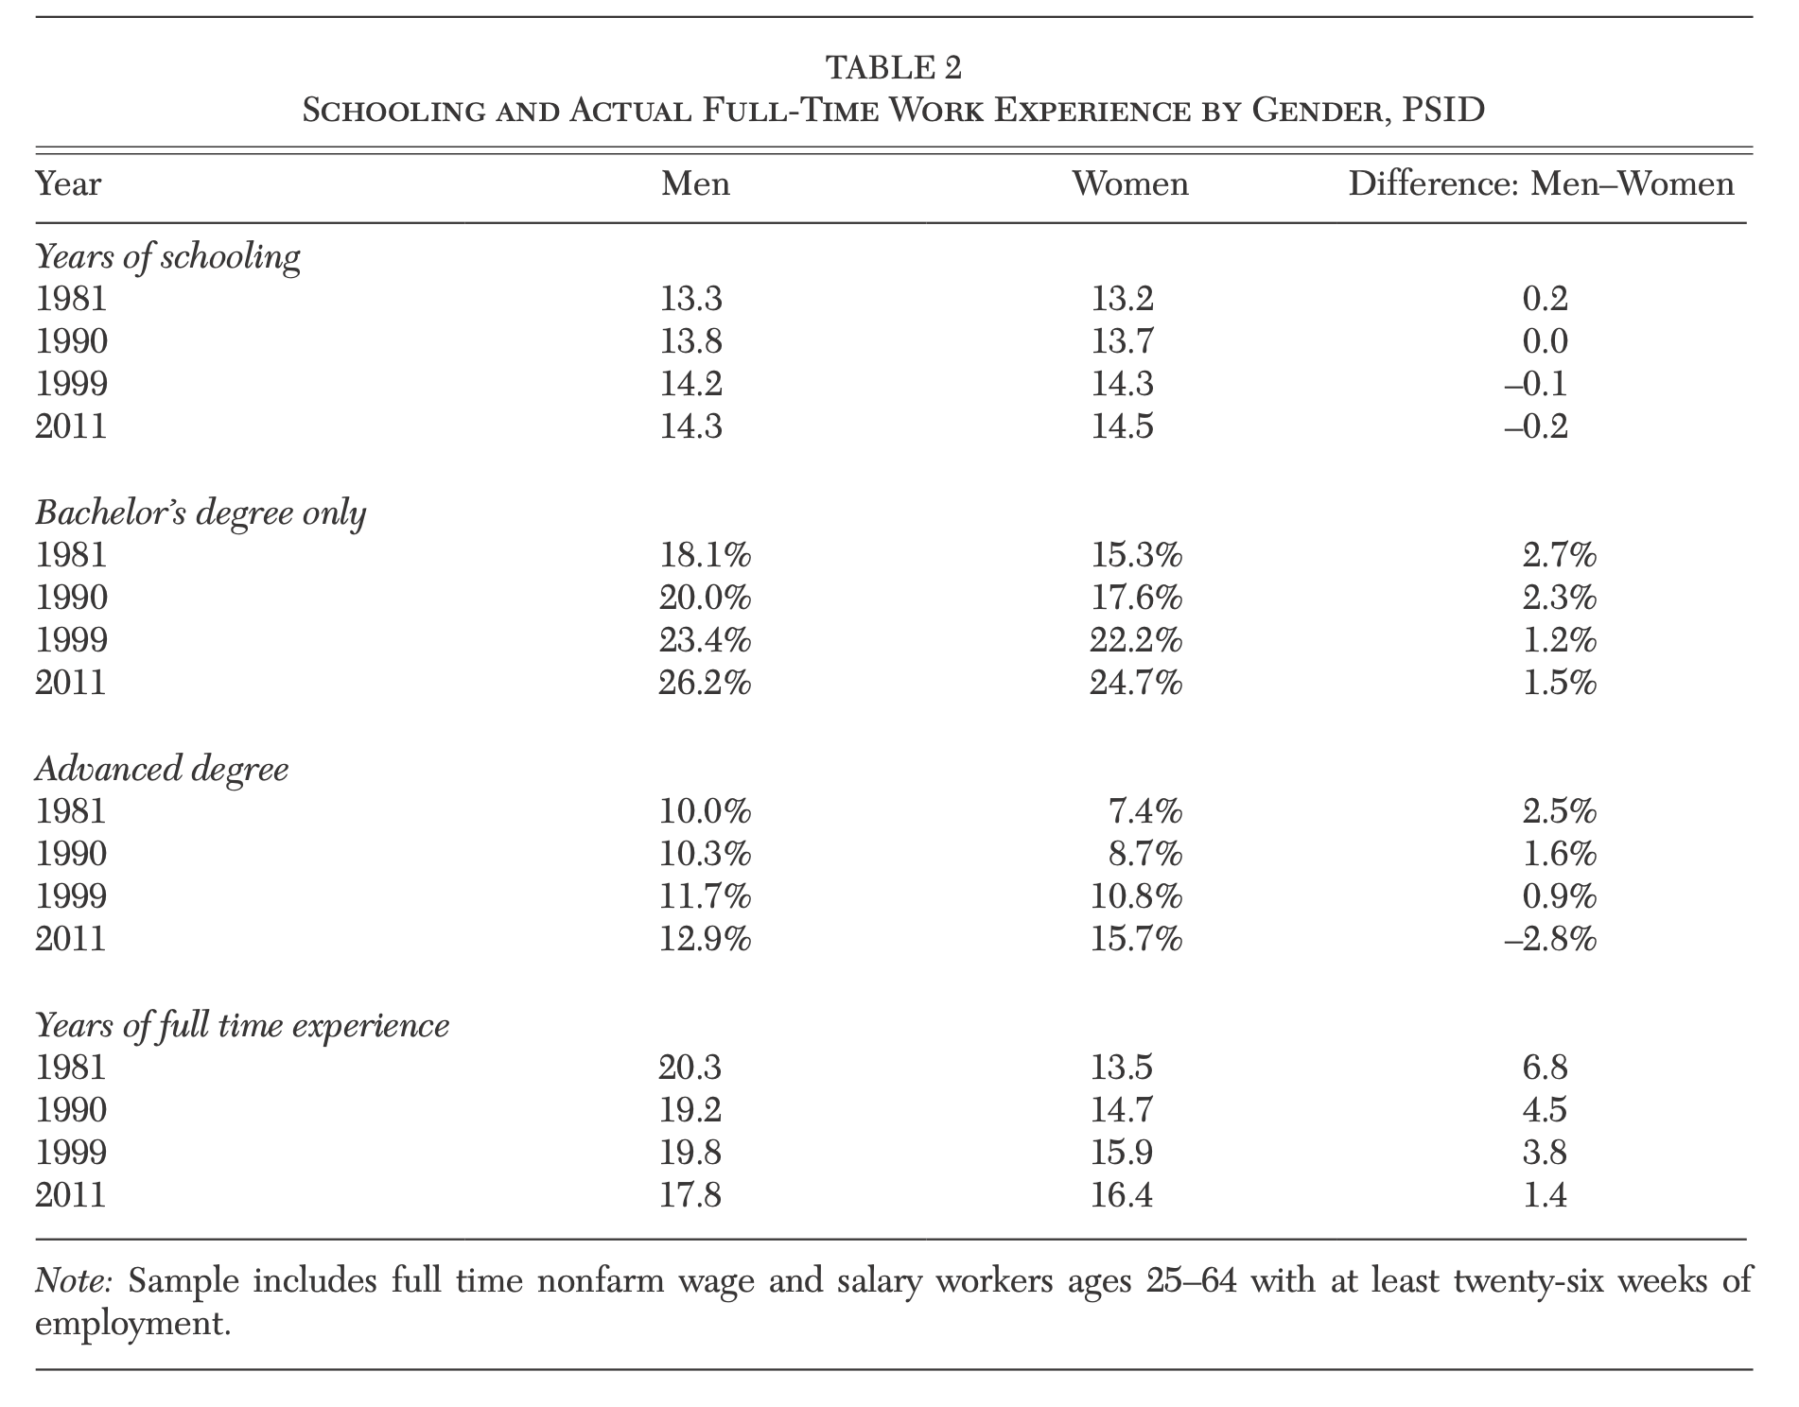

Slide 17
